Slide 1
CURB HIGH CRIME RATE IN MICHIGAN
Adesewa Adesida

Slide 2
Overview
This project is intended to help other countries or cities reduce their crime rates by studying the factors that influence crime such as income, education etc., implementing changes, specifically zoning on Michigan.

Slide 3
Understanding the Problem
Washington, DC used to be the crime capital of The US.
Washington, DC is now one of the safest cities in the world.
Detroit, Michigan is the current crime capital of the US.
How can we reduce crime in DC?

Slide 4
Project Goal
This project is intended to help other countries or cities reduce their crime rates by studying the factors that influence crime such as income, education etc., implementing changes based on DC crime data, specifically zoning on Michigan.

Slide 5




Tools used

Slide 6
The dc crime dataset is a Dataset of all of the crimes in the DC metro police system ranging from Theft, Arson, Assault, Homicide, Sex Abuse, Robbery, and Burglary. Data can be easily geocoded and mapped, trends can be extracted, and predictions can be made.
The Detroit crime dataset, This data reflects reported criminal offenses that have occurred in the City of Detroit. Offense data was extracted from the Detroit Police Department's records management system. This data set contains the most recent data available and is updated anytime DPD sends official crime records contributing to the Michigan Incident Crime Reporting (MICR) or the National Incident Based Reporting systems (reflected by the IBR Date field). It should be noted that some incidents involve the commission of multiple offenses, such as a domestic assault where property was also vandalized. Accordingly, the data describe all offenses associated with all reported incidents.
To be specific, the datasets contain the dates, times, places, type of crime commited, report number, hour of day etc. In summary thes contains most details regarding crimes commited in the respective cities.
Our Datasets

Slide 7
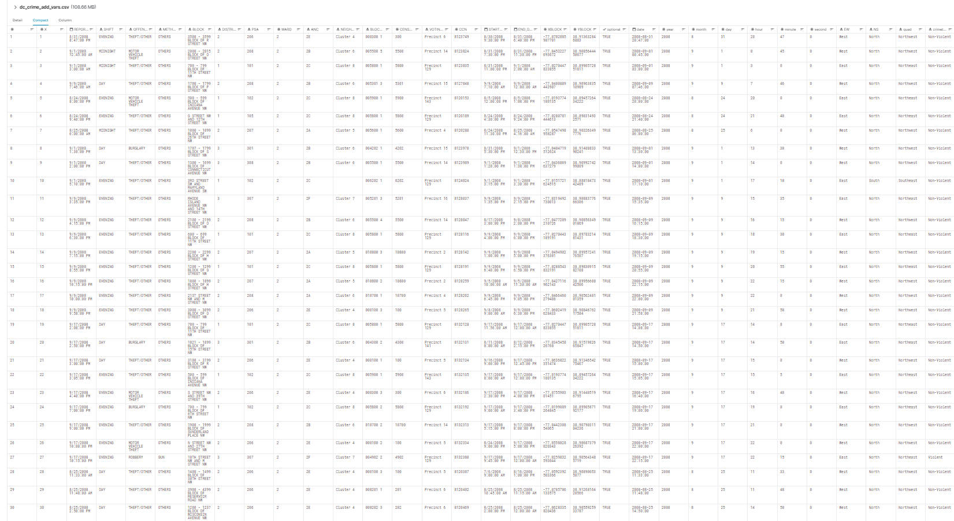
DC CRIME DATASET

Slide 8
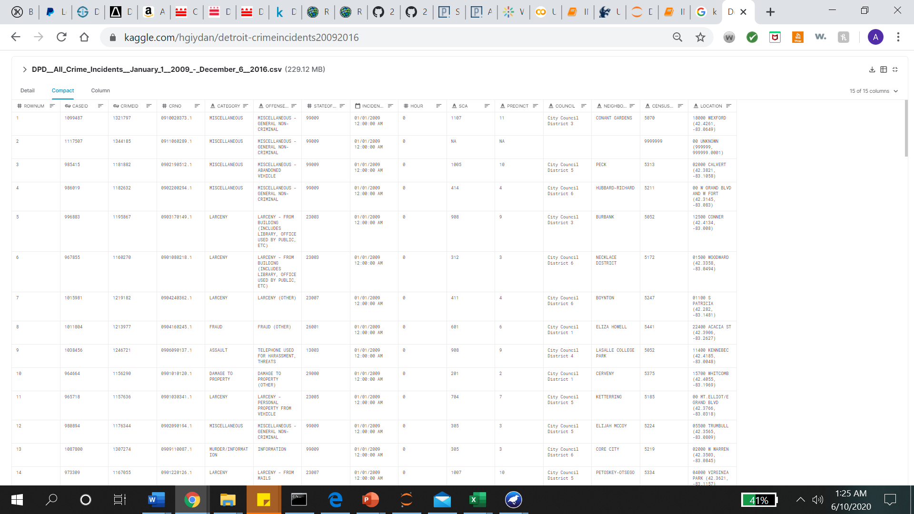
Detroit Data

Slide 9
Preprocessing
Saved dataset as csv file
Loaded data into weka, jupyter notebook
Removed unnecessary data and columns with excessive missing data

Slide 10
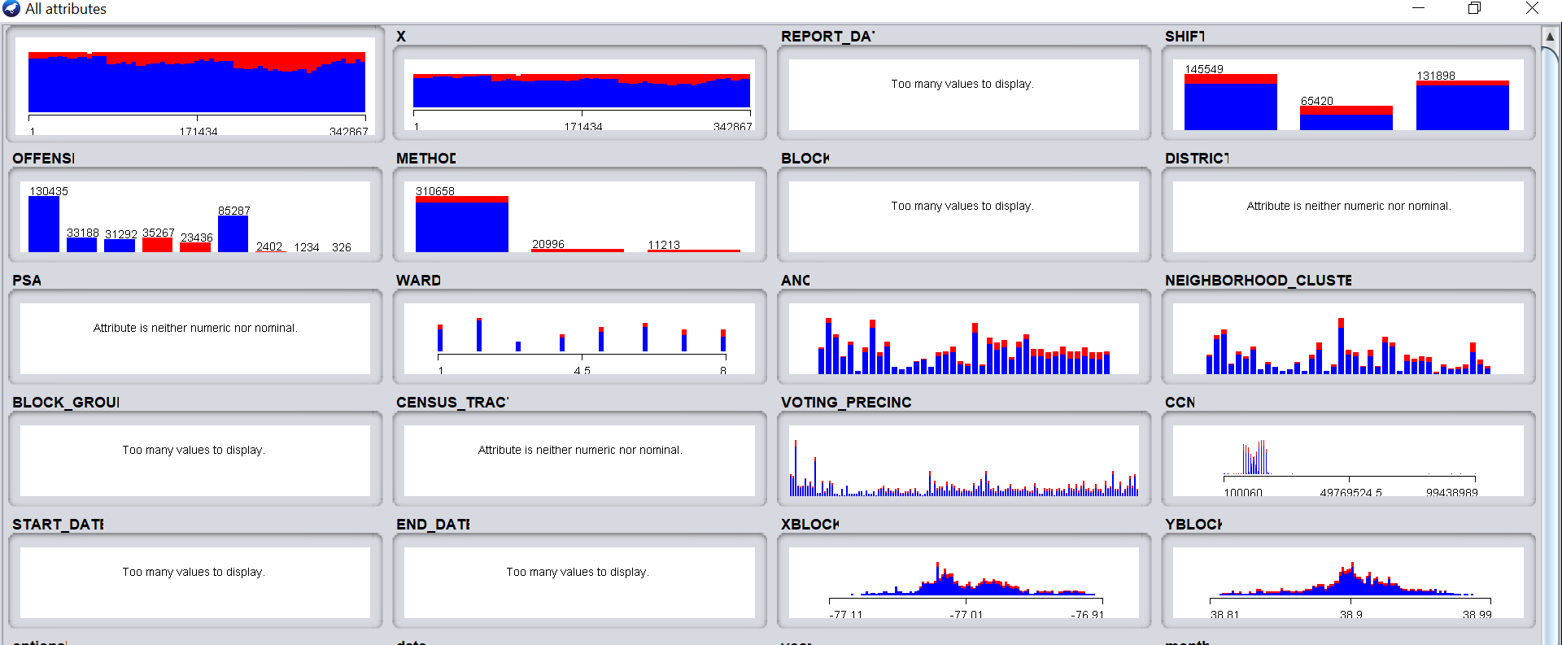
Weka initial visualizations (DC DATA)

Slide 11
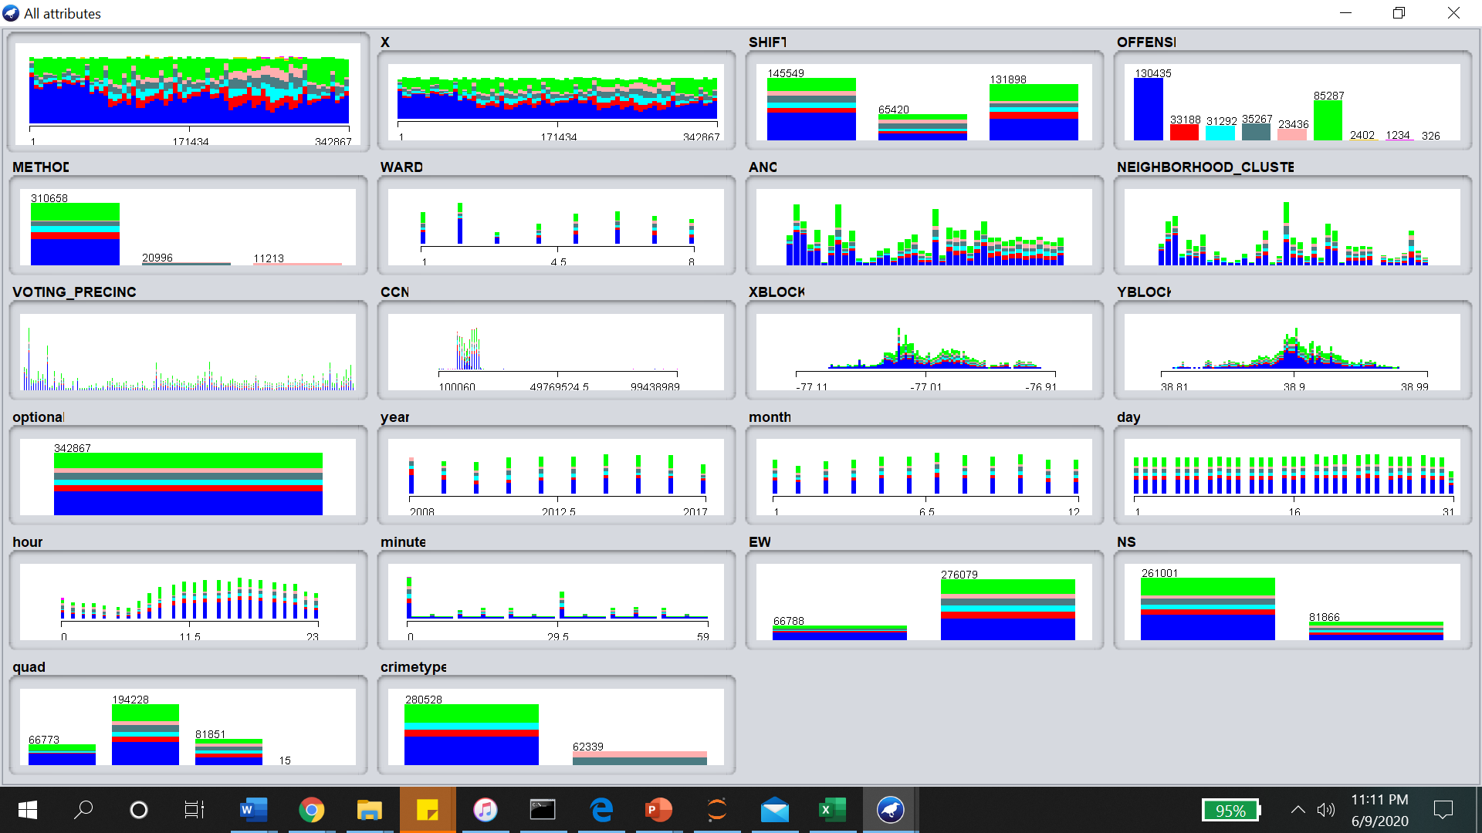
After removing Unnecessary Data (DC DATA)

Slide 12
Identified patterns in DC Data and techniques
Using offense as the class and crime type as the selected attributes on weka visualization. More non-violent crimes in DC than violent (about 82%)
Theft is the most common crime, usually committed with other weapons, not guns and knives.
Most offenses are committed during the Evening and Day.

Slide 13
Exploring Dataset
Used google colab
https://colab.research.google.com/drive/1nNuCoXDd5u09Fcswbhb_pgs5C0AqE7iB?usp=sharing

Slide 14
Visualization
Google colab

Slide 15
Results
More resources should be applied towards curbing theft as the most rampant crime in the United States.

Slide 16
Challenges Faced
Vastness of the data – it was difficult to find the best range fit to use because the data set is very large.
Time – With other courses and covid was very hard to find time to properly work on this project.
Communication

Slide 17
References
https://www.kaggle.com/vinchinzu/dc-metro-crime-data
https://www.kaggle.com/hgiydan/detroit-crimeincidents20092016

